Slide 1
Genesis, Part I
Protology

Slide 2
Genesis has two major parts:
Part 1 = Chapters 1-11, which is the prologue or protology; short stories setting the stage for the larger portion of stories to come.
Part II = Chapters 12-50, which are longer stories of the Patriarchs, starting with Abraham.
Protology = words about “first things” about the beginning of time, creation etc.
Eschatology = words about end times, like Revelation, highly symbolic, picture language.

Slide 3
In Eschatology God is using language to try and describe to us things that have not yet happened, with concepts we do not know or have not experienced; i.e. the end will be worse than the greatest earthquake, the greatest war we have experienced. The New Jerusalem (heaven) will be 1 mile cubed, fortified by a huge wall = secure & safe. The writers used the language of their time to paint a picture for us – streets paved with gold = precious and beautiful.

Slide 4
Protological Language = a symbolic use of words that our experience understands to describe things we haven’t experienced.
Genesis 1-11 in one sense IS HISTORICAL; they describe events that happened; but they are also SYMBOLIC, not intending to give us a history of human civilization or an exact science on how God started everything. There is a lot that is not included.
What was left out was not considered important, for it is a selective, religious history
Notes:
Just as a former President needs to be selective in what to include in his/her biography, so the Bible is selective in what information to share. There is so much we do not know, i.e. where did Cain get his wives? Where did Noah’s sons get their wives? What was the culture like at the time of Noah? It is hard to compare what was important to the writers and their culture in Biblical times versus what is important to us in our time and culture. In Biblical times Genealogies were important for cultural reasons but they are not so important to us. In our culture scientific details about how things came to be and how things work are important, but these things were not important to people in that time. Many things are left out as unimportant to the over all theme that the Biblical text wants to present.

Slide 5
Protology and all the Bible is selective history in support of a theme. All history has some objective in mind.
The topic of the OT is Religion = People’s relation to God
Myths are “timeless” stories of how things came to be & explanations of “eternal” things, like why is there evil? Where do the sun and moon come from? Why is the world like it is?
Notes:
Most ancient peoples developed these myths to help make sense of their world, and they were seen as timeless stories that repeated themselves, one eternal cycle.

Slide 6
The Bible is different! Instead of timeless stories of long ago, the Bible focuses on events in human history in a particular culture at specific geographical locations.
The OT pulls out important events to show the flow of God’s plan being worked out over the centuries.
There is a beginning to God’s plan and a goal. This is new compared to other ancient, religious myths. Other myths are cyclical, the Bible is linear, moving toward a climax or goal.

Slide 7
OT creation story is in space, in time, in human history vs. the “timeless” myths of other cultures.
The Bible | Myths
God creates nature | Nature personified as deities
God Created All Things | Conflict b/w gods explains events
History is Linear | History is Cyclical
Notes:
The Genesis story is radically different than the creation myths of other Ancient Near Eastern religions. Instead of the world and events being explained as an accidental consequence of the conflict between various deities (like a storm being the result of a conflict between the storm god and the sea god), Genesis confesses that there is only one God and that God created all things.

Slide 8
Genesis 1 and 2 are not a history of the beginning of the world or a science book
These stories are making a religious statement about God and His relationship to the world
Genesis 1-11 is a beginning to lead into the main story about Abraham & the Patriarchs
The Bible vs. Modern Science The Bible does not give us enough information to compare it with Biology, Cosmology or Geology
The Bible is not interested in Science.

Slide 9
The Bible is talking about creation, science is trying to understand “how” – It is not the same type of literature.
The Bible says “God created” but does not get into all the details of “how”
Scientific Theories are guesses; so don’t force Biblical information into a present theory that may change. Let science be science.
Science is the study of nature. The Bible does NOT say that the world is Not 4.5 billion years old.
Notes:
We do not honor the Bible if we try to turn it into a scientific text and we do not honor science by looking to it to for ultimate answers about purpose or meaning.

Slide 10
Don’t believe scientific theories in a “religious” sense – as answering absolute questions of purpose or meaning.
Don‘t try to take scientific data out of the Bible.
Early Humans The fossil record seems to show a theory of evolution from apes, to early humans, to later humans. There are 4 possible explanations of the data:

Slide 11
What we have in the fossils is only different kinds of apes who died out, with no DNA connection with humans.
Accept Evolution, but that God designed and directed it. God made the changes to go from ape to human (i.e. gave a soul to the ape to become human)
This is devolution – God created humans, but along the way there are genetic mutations that come off the stalk, the mutants died out, humans survived, others mutated away.

Slide 12
We don’t know. We don’t have enough information.
There are a lot of unproven assumptions in scientific theories and some evidence in science that argues against accepted theories; don’t build too much on unproven guesses
The Bible distinguishes humans from animals in three ways (and science backs this up) – Humans are the only creatures that:
1) use language; 2) have a conscience; and 3) worship

Slide 13
Animals communicate using sounds etc., but humans go way beyond this with the gift of language.
Animals have instincts, but not a sense of guilt or remorse about wrong behaviors. Humans are the only creatures that have regret or guilt
Humans are the only animals that worship – that believe there is some higher power/s that they want to connect with, communicate with, manipulate etc.

Slide 14
Humans were created in God’s image – Not physically, but spiritually in some way. We share something of God’s spiritual quality: made for perfect, selfless love of God & others, made to use language & reason, made with a conscience – the things the other animals don’t share.
What do the 6 Days of Creation mean? What was a “day” before the sun was created (on “day 4”)? Language is used for something like we experience to describe something we have not experienced. This is a religious account.

Slide 15
How fast did time take in the days of creation? How do you talk about time when God was busy creating time? God starts by separating light from darkness – for lack of a better term, it is called “the first day” – not necessarily a solar (24 hour) day. It could be an era of time. We have to be careful about putting our concept of time on these chapters when God was “setting up time.” God can create the world in a way that defies our full understanding of it. We don’t have time increments in the creation story to correlate with modern science.

Slide 16
God created in 6 phases
There are difficulties in trying to fully gel the creation account with the Neo-Darwinian concept of Evolution.
We need to take the Genesis story as it is: Creation is a miraculous event
The Fall into Sin story illustrates 5 things:
This was a deliberate act
Role of the Tempter – Satan – an intelligent, fallen angel interferes with God’s plan

Slide 17
Effects of Sin: Sin causes separation or a breakdown in relationship between humans and:
  God
  Other Humans
  Nature
  Self
Sin is a Twist or Corruption of God’s good creation. Adam’s sin is like a virus, it infects everything and corrupts, warps, twists everything. We become fully depraved.

Slide 18
Loss of Paradise: God evicts humanity from paradise, barring them from eating of the “fruit of life” so they might not live forever in their sin, and as a punishment.
The Flood What does it mean “The Whole Earth” was covered with a flood? Some think it was the whole “known” world to the people of the time, so a “local” flood. Be careful about “geological” evidence. It can be interpreted various ways. We are talking about “a miracle”.

Slide 19
Point of the Flood Story: God started over because sin and evil was so rampant.
Tower of Babel Shows humanity’s rebellious nature – They want to exalt themselves to God’s level by building an artificial mountain – a Ziggurat. God judges them by mixing up their languages and scattering them into different nations.

Slide 20
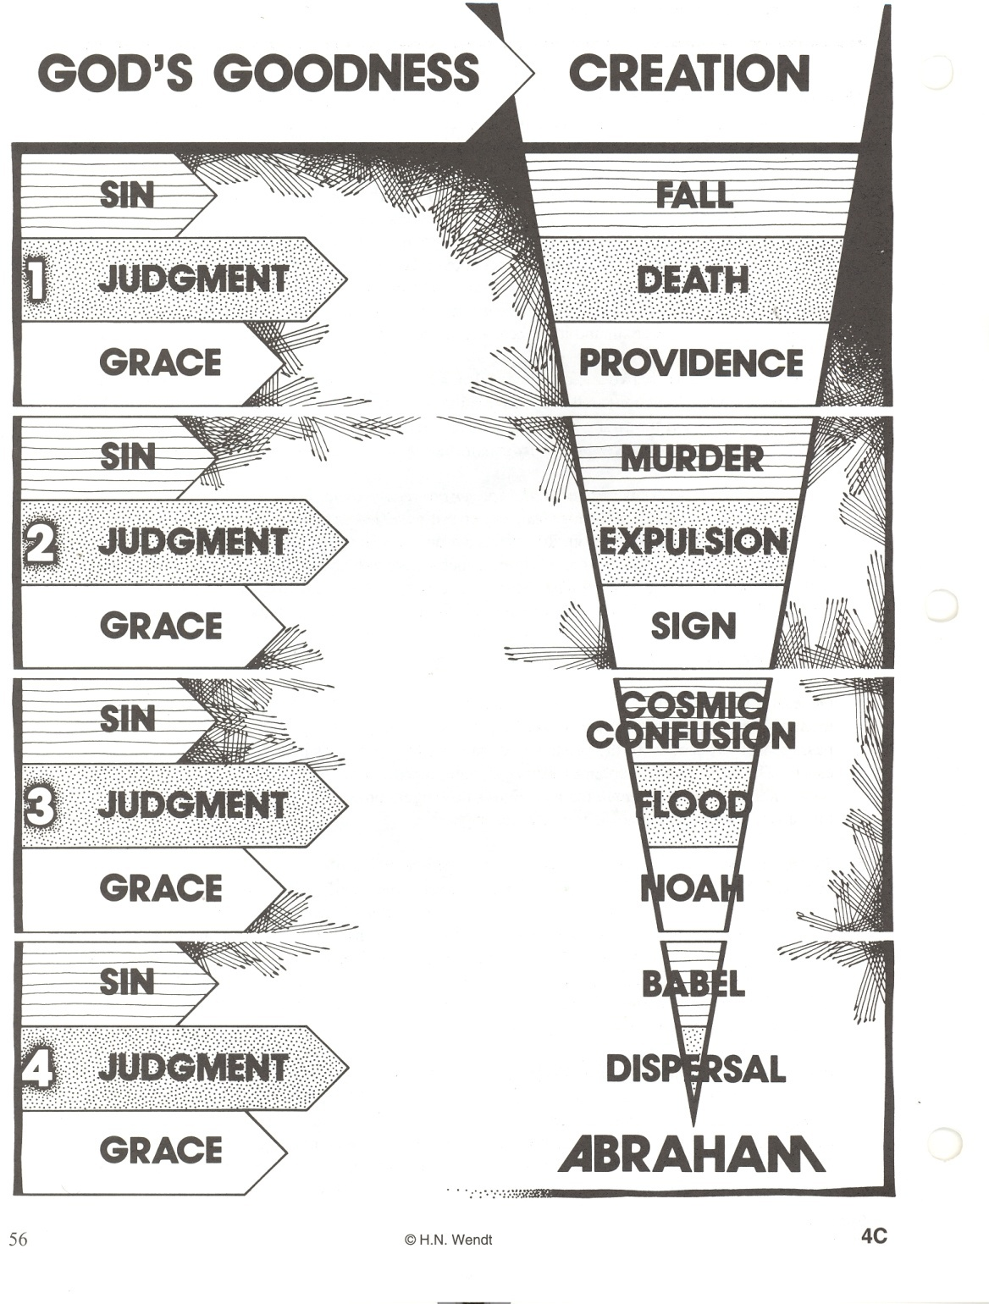
Notes:
This illustration shows the pattern throughout the stories in Genesis 1-11: Sin, Judgment, Grace. The Greek word translated “grace” means “gift”. Another definition of grace is “undeserved mercy”. The original sin is called The Fall. Satan tempts Eve who eats the forbidden fruit, then Adam eats of it and, as God predicted would happen if they ate of that tree, the curse of death came upon God’s good creation. And yet, grace is shown by God by providing for Adam and Eve. He makes animal skin clothes for them since they are now ashamed of their nakedness and He makes a promise that some “seed” or descendant of Eve will arise in the future and destroy Satan and his work. Next, the sin is murder as Cain kills his brother Abel out of jealousy. The judgement is expulsion, as Cain will have to wander from place to place and no one will want anything to do with him. But grace is shown as God puts some type of mark upon Cain to protect him from someone wanting to avenge Abel’s death. Next, we are told that at the time of Noah the world was so sinful that people were “only evil all the time.” It got so bad that fallen angelic beings were trying to have improper relationships with human women. The judgment was that God destroyed the world with a flood. But grace was shown as God started over by saving Noah and his family and the animal species on the ark. Finally, the Babel story shows the sin of human arrogance as a civilization living in Mesopotamia builds a high tower to “make a name for themselves” and to try and “storm heaven.” God’s judgment is mixing up their languages and scattering them to become different nations. Grace is shown as God calls Abraham in chapter 12 to start His plan anew to bring a Savior from Abraham’s descendants who will bring blessing to the whole world.

Slide 21
Genealogies: (Genesis 5 & 10) The numbers should not be added up! The numbers often follow a stylized format, i.e. 10 generations b/w Adam and Noah, 10 b/w Noah & Abraham etc. Or Matthew’s Gospel, where he gives 3 sets of 14 generations for Jesus’ Genealogy (probably the significance of “7” being symbolic of God’s perfect plan, & “10” being symbolic of “completeness” – The complete number of generations as summarized by . . . )

Slide 22
We have lost the key to the numerical schemes, but they are symbolical; not all the steps or generations are included so that it fits into their scheme.
The Genealogies should not be used for time calculations!

Slide 23
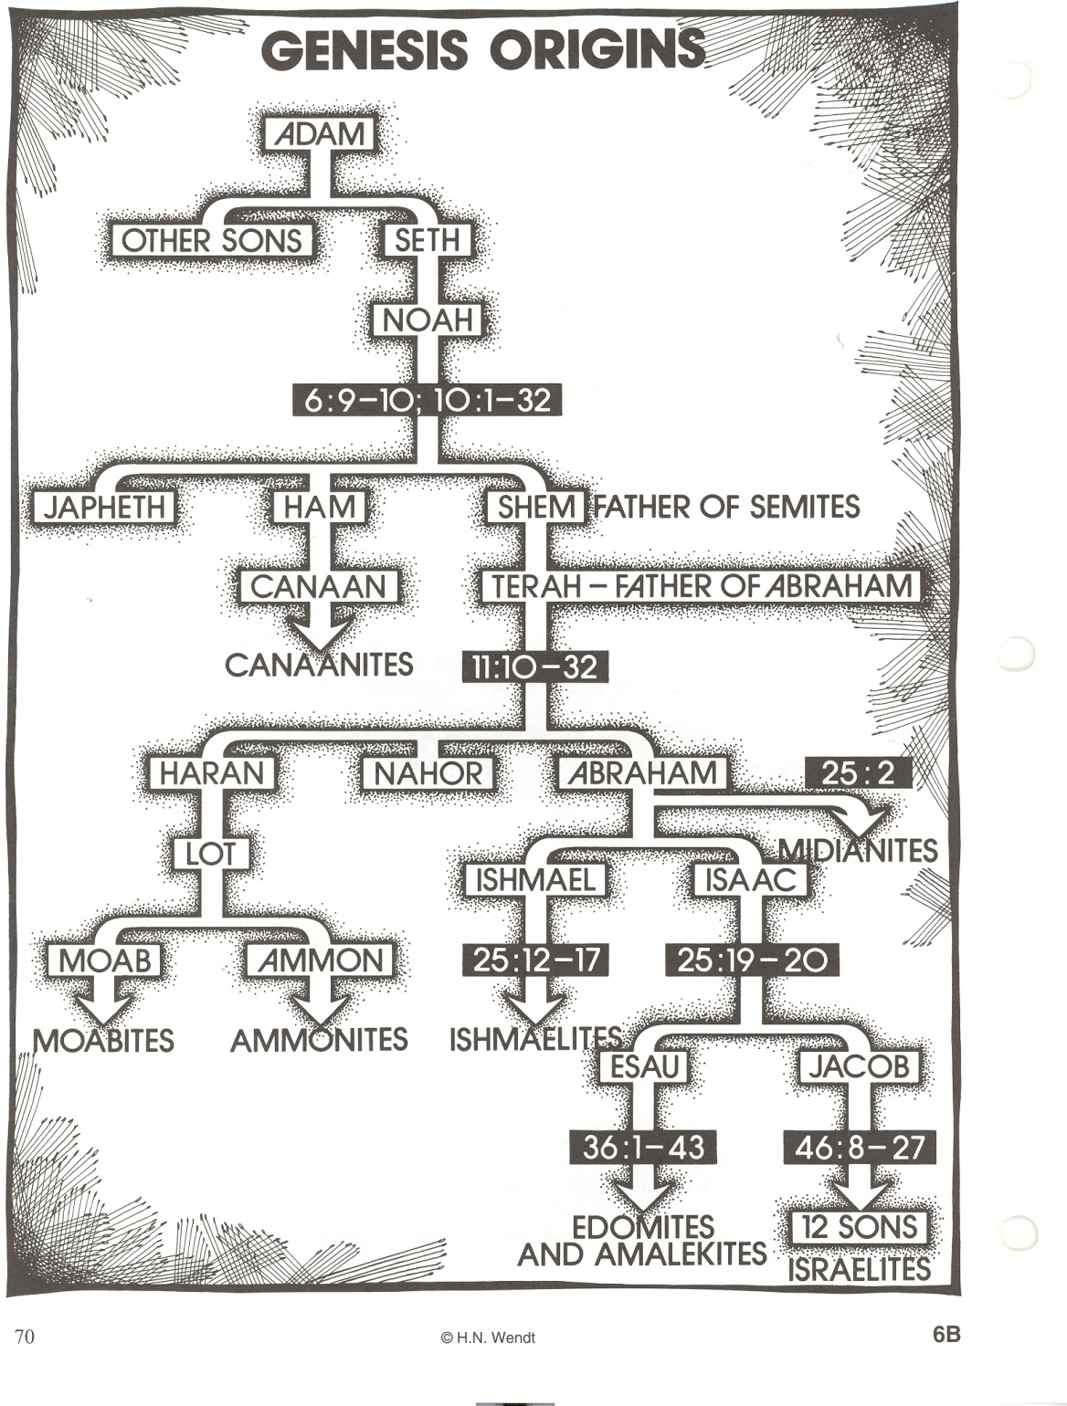
Notes:
Again, the genealogies should not be used to calculate how old the world is. Not all steps or generations are included. Genealogies are used in the Bible to make a point. As the above chart shows, one point of sharing the genealogies was to show the relationships between Israel and her neighbors. They are related to all of the various nations around them and sometimes the origins of various tribes or nations is shared to explain the strained relationships.

Slide 24
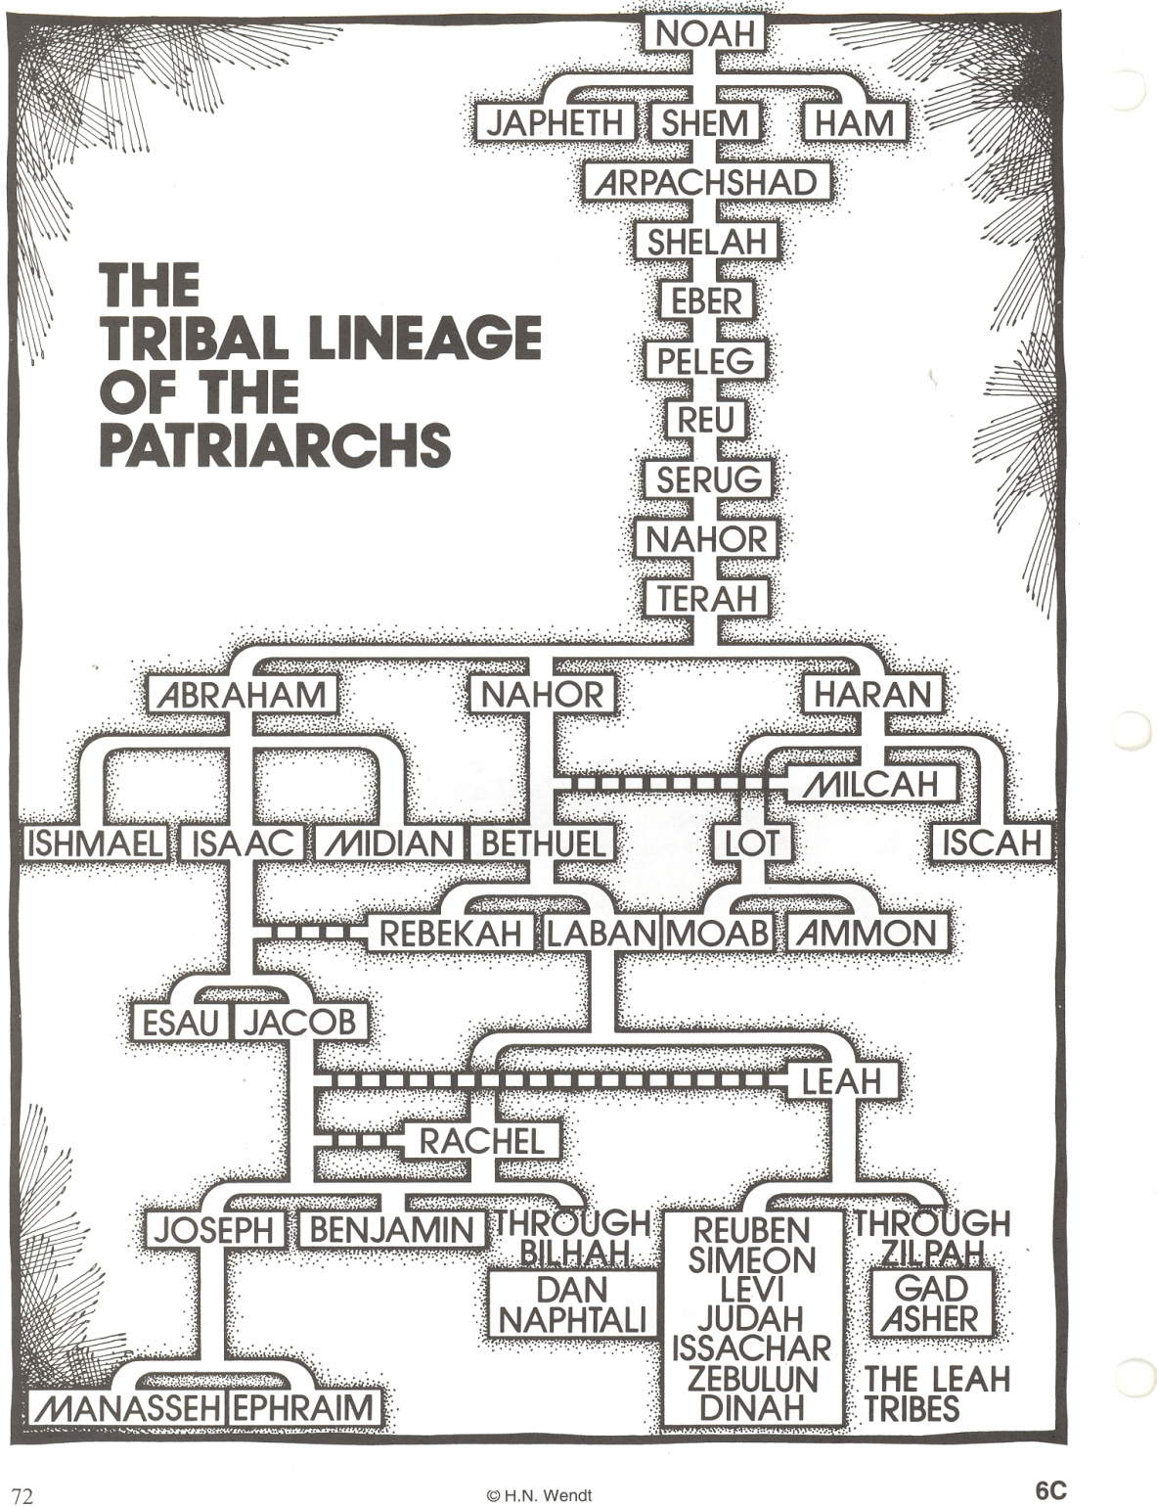
Notes:
Again, most certainly not every generation is shown. In Biblical genealogies it was not important to be precise about every single descendant, but to show some for the purposes of your theme and to explain relationships. Notice, the 12 tribes of Israel will actually come from 10 of Jacob’s sons and his two grandsons from Joseph.

